Slide 1

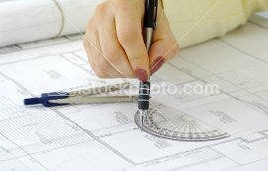
Chapter 5
Pictorial Sketching

Slide 2
Objectives
Be able to explain the difference between an
axonometric projection and an oblique
projection.
Be able to explain the difference between an
isometric projection and an isometric
drawing/sketch.
Be able to create an isometric and oblique
sketches from an actual object and multiview
drawing.

Slide 3

Axonometric
& Oblique
Projection

Slide 4
Axonometric Projection
Parallel & normal
to picture plane
B
A
Line
of
sight
D
C
B
A
D
C

Slide 5
Axonometric Projection
Type of axonometric drawing
Axonometric axis
a
1. Isometric
All angles are equal.
b
c
B
A
B
a
Axonometric axis
A
D
C
2. Dimetric
c
Two angles are equal.
D
b
C
a
Axonometric axis
3. Trimetric
c
None of angles are equal.
b

Slide 6
Oblique Projection
Parallel & oblique
to picture plane
A
Line
of
sight
A
B
B
C
C
D
D

Slide 7
Oblique Projection
Oblique drawing angle
45º
60º
A
30º
B
C
Type of Oblique drawing
A
B
D
1) Cavalier
2) Cabinet
C
D
Full
scale
Half
scale
45º
45º

Slide 8
Isometric Projection
& Isometric drawing

Slide 9
Isometric Projection
Rotate 45°
about vertical axis
Tilt forward (35º16’)
All edges foreshorten
about 0.8 time.

Slide 10
Isometric Drawing
Isometric drawing is a drawing drawn on an isometric
axes using full scale.
Isometric projection
(True projection)
Isometric drawing
(Full scale)
Forshorten
Full scale

Slide 11
Positions of Isometric Axes
Isometric axes can be arbitrarily positioned to create different views of a single object.
Regular
isometric
Reverse axis
isometric
Long axis
isometric
View point is looking
down on the top of
the object.
View point is looking
up on the bottom of
the object.
View point is looking
from the right (or left)
of the object.

Slide 12
Distance in Isometric Drawing
True-length distances are shown along
isometric lines.
Isometric line is the line that run parallel to any of the isometric axes.
Nonisometric lines
Isometric axes

Slide 13
Isometric
Sketching

Slide 14
Sketch from an actual object
1. Place the object in the position which its shape
and features are clearly seen.
2. Define an isometric axis.
3. Sketching the enclosing box.
4. Estimate the size an and relationship of each
details.
5. Darken all visible lines.

Slide 15
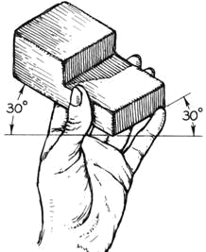
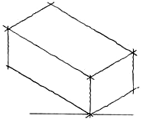
Sketch from an actual object
STEPS
1. Positioning object.
2. Select isometric axis.
3. Sketch enclosing box.
4. Add details.
5. Darken visible lines.

Slide 16
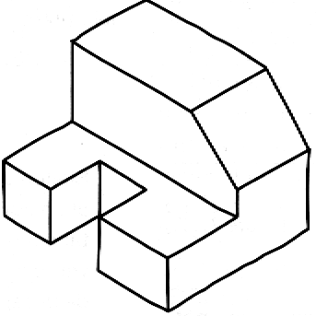
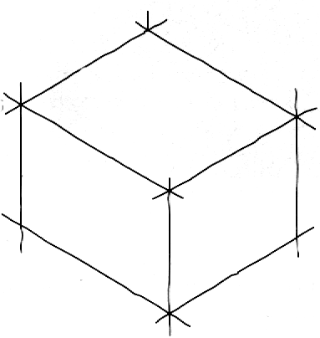
Sketch from an actual object
STEPS
1. Positioning object.
2. Select isometric axis.
3. Sketch enclosing
box.
4. Add details.
5. Darken visible lines.
Note
In isometric sketch/drawing), hidden lines are omitted
unless they are absolutely necessary to completely
describe the object.

Slide 17
Sketch from multiview drawing
1. Interprete the meaning of lines/areas in
multiview drawing.
2. Locate the lines or surfaces relative to isometric
axis.

Slide 18
Example 1 : Object has only normal surfaces
Top
Regular
H
Top View
Front
Side
W
D
Front View
H
Side View
W
D
Side
Front
Reverse
Bottom View
Bottom

Slide 19
Example 2 : Object has inclined surfaces
D
Nonisometric line
θ
y
H
y
x
x
Front View
W

Slide 20
Example 3 : Object has inclined surfaces
x
C
B
A
x
x
x
B
C
A
y
y
C
B
A
Nonisometric line

Slide 21
Example 4
Regular
x
y
C
E
B
D
F
Front View
A
B
C
D
Reverse
A
F
E

Slide 22
Circle & Arc in Isometric
In isometric drawing, a circle appears as an ellipse.
Sketching Steps
1. Locate the center of an ellipse.
2. Construct an isometric square.
3. Sketch arcs that connect the
tangent points.

Slide 23
Circle & Arc in Isometric
Four-center method is usually used when drawn an isometric ellipse with drawing instrument.
Sketching Steps
1. Locate the center of an ellipse.
2. Construct an isometric square.
3. Construct a perpendicular
bisector from each tangent point.
4. Locate the four centers.
5. Draw the arcs with these centers
and tangent to isometric square.

Slide 24
Example 5

Slide 25
Irregular Curve in Isometric
Steps
1. Construct points along the
curve in multiview drawing.
2. Locate these points in the
isometric view.
3. Sketch the connecting lines.

Slide 26
Oblique
Sketching

Slide 27
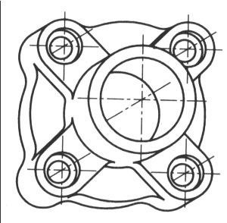
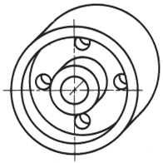
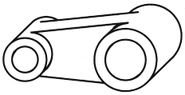
Object Orientation Guidelines
Place complex features (arc, hole, irregular shape
surface parallel to frontal plane.

Slide 28
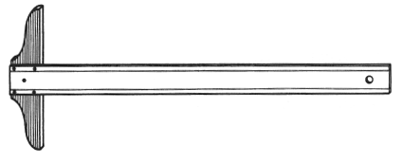
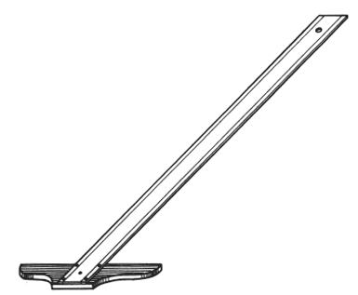
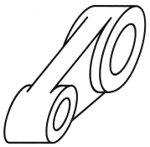
Object Orientation Guidelines
The longest dimension of an object should be
parallel to the frontal plane.
GOOD
GOOD
WORSE
WORSE

Slide 29
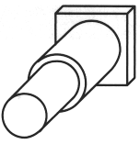
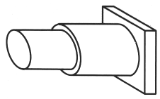
Object Orientation Guidelines
Which orientation is better ?

Slide 30
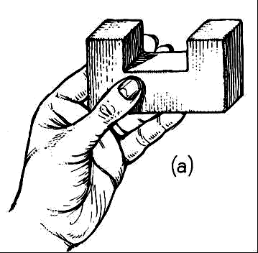
Sketch from actual object
ESTIMATE DEPTH
ESTIMATE LINES
D
45°

Slide 31
Sketch from multiview drawing

Slide 32
Sketch from multiview drawing

Slide 33
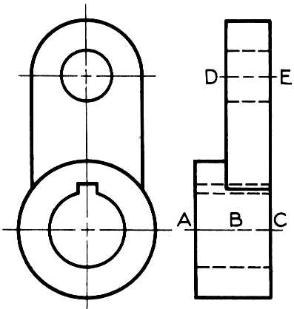
Sketch from multiview drawing
E
D
C
B
A

Slide 34
Sketch from multiview drawing
E
D
C
B
A

Slide 35
Sketch from multiview drawing
E
D
C
B
A

Slide 36
Sketch from multiview drawing
E
D
C
B
A

